Slide 1

MEE 433 MECHANICAL VIBRATIONS
Modal Analysis of Airplane Wing
BY
Deepak Prajapati: 10BME 1034
Yash Ganatra: 10BME 1043

Slide 2
Abstract
In this project, modal Analysis of airplane wing will be done using ANSYS software to determine the natural frequencies. If the frequency of vibration matches with the natural frequency of aircraft wing resonance occurs and this has disastrous consequences. NACA 0012 airfoil has been chosen as the standard due to its widespread use. Aluminum 6061 T-6 and Titanium 3.7165 have been chosen as the standard materials as they are widely used in the manufacture of aircraft wings.

Slide 3
Modal Analysis
Modes are inherent properties of a structure, and are determined by the material properties (mass, damping, and stiffness), and boundary conditions of the structure. Each mode is defined by a natural (modal or resonant) frequency, modal damping, and a mode shape (i.e. the so-called “modal parameters”).
Problem Specification:
A wing with a NACA 0012 airfoil section is supported such that one end is fixed and the other end is free. The wing has a chord of 1 meter, a span of 5 meters, and a thickness of 0.01 meters.

Slide 4
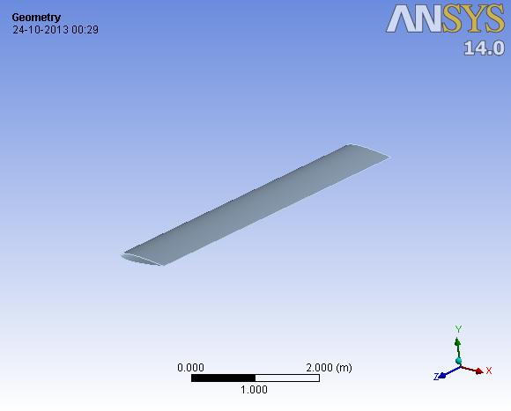
Approach
To find the mode shapes, airfoil geometry is modeled in ANSYS Workbench. The coordinates of the airfoil are obtained from http://www.ppart.de/aerodynamics/profiles/NACA4.html. NACA 0012 is a symmetric airfoil as it has zero camber. It is 12% as thick as it is long.

Slide 5
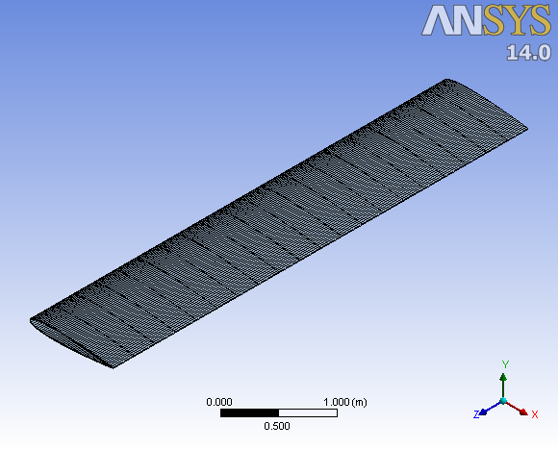
After modelling the geometry, discretization is done. Mapped Face Meshing and Edge sizing features are used to create a mesh mapped into the rectangular domain.

Slide 6
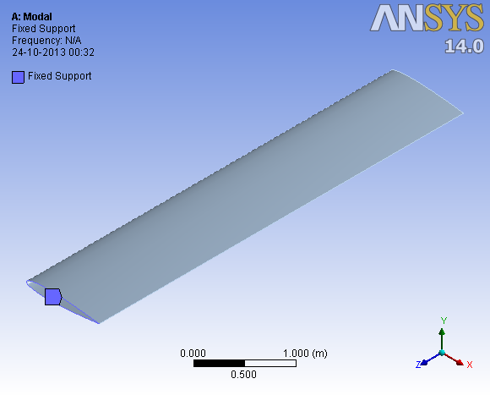
The wing is assumed to be fixed at one end hence Fixed Support is used while defining the boundary conditions.

Slide 7
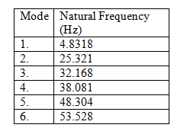
Results
a. Aluminum 6061-t6
The properties of Aluminum 6061-T6 are:
Elastic Modulus: 1e7 psi Density: 2700 kg/m³
The first 6 natural frequencies are shown in Table 1.

Slide 8
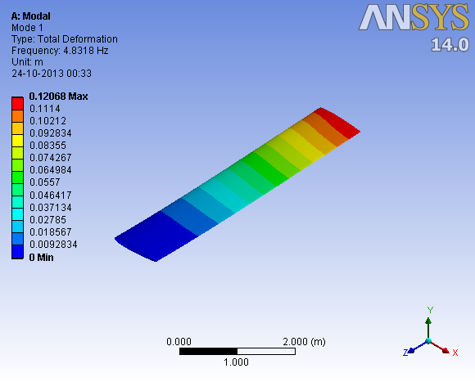

Slide 9
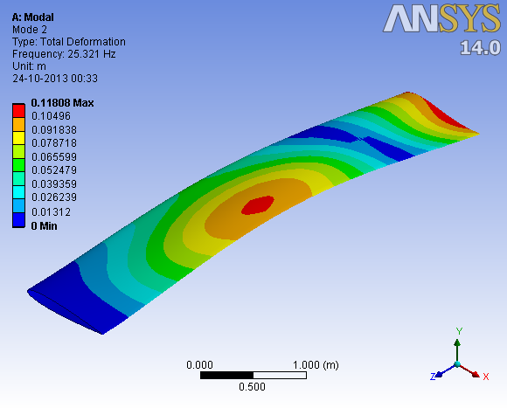

Slide 10
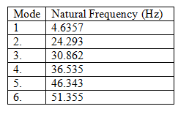
b. Titanium 3.7165
The properties of Titanium 3.7165 are:
Elastic Modulus: 1.5e7 psi Density: 4400 kg/m³

Slide 11
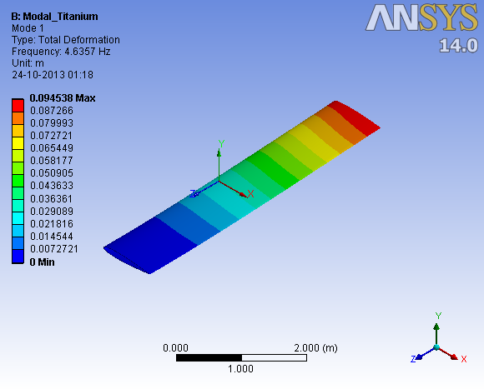

Slide 12
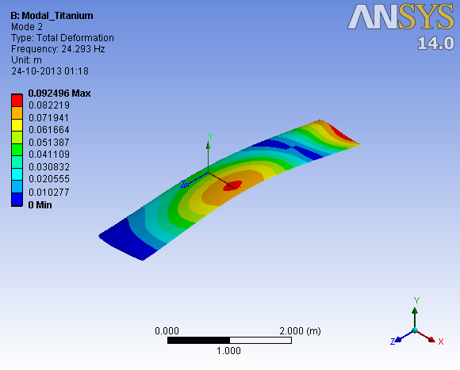

Slide 13
Conclusion and References
Conclusion:
It can be established from the modal frequencies that due to higher elastic moduli of Titanium 3.7165 compared to Aluminum 6061 T6 the amount of deflection is lower in Titanium 3.7165 than in Aluminum 6061-T6.
References:
[1] MODAL ANALYSIS, Patrick Guillaume, Department of Mechanical Engineering,Vrije Universiteit Brussel
[2] Strain-Based Analysis for Geometrically Nonlinear Beams: A Modal Approach, Weihua Su and Carlos E. S. Cesnik, 53rd AIAA/ASME/ASCE/AHS/ASC Structures, Structural Dynamics and Materials Conference,2012
[3] http://www.makeitfrom.com/material-data/?for=6061-T6-Aluminum
[4] http://www.makeitfrom.com/material-data/?for=Grade-5-6Al-4V-3.7165-R56400-Titanium

